Slide 1


Optimizing of Controller Placement based on Hybrid GenClust Algorithm for DDOS Mitigation on Software Defined Network
Master of Science in Computer Engineering
Sahaj Shakya
2019-1-39-0020
Nepal College of Information Technology
Faculty of Science and Technology
Pokhara University, Nepal
January 28th , 2021
<number>

Slide 2

Outlines
01
BACKGOUND
02
PROBLEM STATEMENTS
03
SIGNIFICANCE OF STUDY
04
LITERATURE REVIEW
05
PROPOSED METHODOLOGY
06
EXPECTED OUTPUT
07
VALIDATION CRITERIA
08
REFERENCES
<number>

Slide 3
1. BACKGROUND
<number>

Slide 4
Background
BOTNETS
ATTACKER
VICTIM
4

Slide 5
2. PROBLEM STATEMENTS
“The first step to solve a problem is to find the problem.”
<number>

Slide 6
Problem Statement
Impact of a DDOS attack usually consists of loss of services.
In case of DDOS detection and prevention based (Research Gap).
Maximum Controller detection overhead [1]
150 switches in a system can handle up to 20,000 new flow requests.
computational overhead impact controller performance.
multiple OpenFlow controllers mitigate the problem
False Negative and False Positive Value
False negative values when parameter set to a low value. [6]
Attacker will low flow does less damage
Multiple combination of machine learning algorithm mitigate the problem [2]
6

Slide 7
3. CONCEPTUAL MODEL
<number>

Slide 8
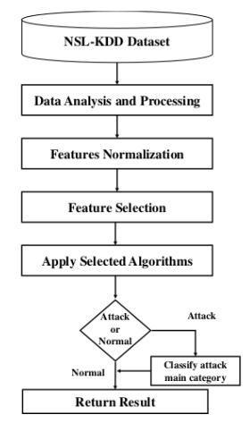
Conceptual Model
3. 1 Conceptual Algorithm based on NSL-KDD Dataset
Fig 3.1 Conceptual Analysis Model of NSL-KDD Dataset
8

Slide 9
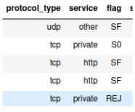
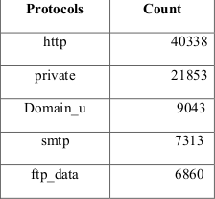
Conceptual Model
3. 1 Conceptual Algorithm based on NSL-KDD Dataset
3.1.1 Data Analysis and Processing
Training Data set divided as
protocol_type
services
flag
label
Fig 3.1.1 Features
Fig 3.1.2 Distributions
8

Slide 10
Conceptual Model
3. 1 Conceptual Algorithm based on NSL-KDD Dataset
3.1.2 Features Normalization
Normal traffic assumed as 0
Rest of traffic assummed as 1
Correlated to normalized into range [0, 1]
𝑋 ′′ 𝑖𝑗 = 𝑋 𝑖𝑗 − 𝑋𝑚𝑖𝑛 / 𝑋𝑚𝑎𝑥 − 𝑋𝑚𝑖𝑛 (3.1.2)
Where,
X min = min [X’ ij ]
X max = max [X’ ij ]
8

Slide 11
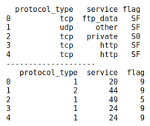
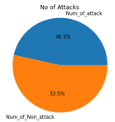
Conceptual Model
3. 1 Conceptual Algorithm based on NSL-KDD Dataset
3.1.3 Standardization
label encoder and onehotEncoder used to assign the string value to binary values.
𝑋 𝑖𝑗 = 𝑋 𝑖𝑗 −𝑀𝑒𝑎𝑛 𝑗 / 𝐴𝑣𝑔𝐷𝑒𝑣 𝑗
Fig 3.1.1 One hot Encoding of Protocols
Fig 3.1.2 Features in NSL-KDD Dataset
8

Slide 12

Conceptual Model
3. 1 Conceptual Algorithm based on NSL-KDD Dataset
3.1.3 Standardization
Standardization is given by
Standardization = Sum of type of Traffic / length
Attack types can be ‘Ddos’, ‘Probes’, ‘U2R’, ‘R2L’
Fig 3.1.3 Distributions of Attacks
8

Slide 13
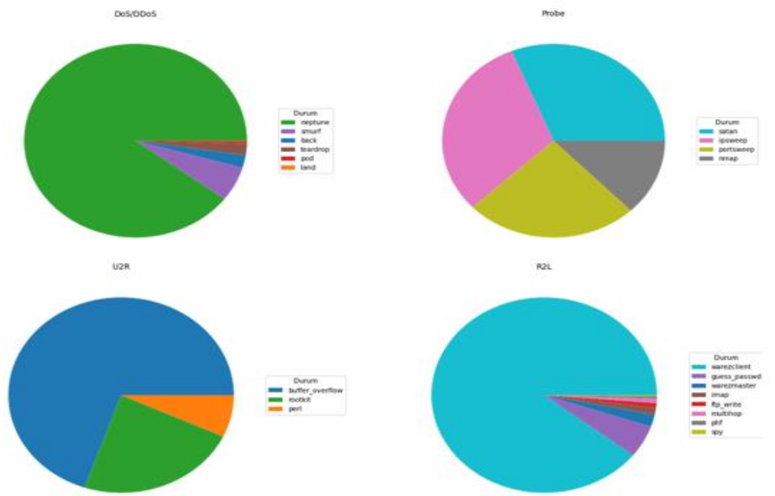
Conceptual Model
3. 1 Conceptual Algorithm based on NSL-KDD Dataset
3.1.3 Standardization
8
Fig 3.1.4 Standard Distribution of Attack types

Slide 14
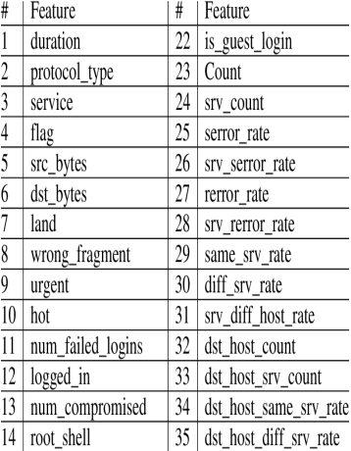
Conceptual Model
3. 1 Conceptual Algorithm based on NSL-KDD Dataset
3.1.4 Features Selections
dimension reduction that involves picking a subset of original features
reducing the amount of features, removing unnecessary
Wrapper analyzes the usefulness of features and filter evaulates intended features
Two techniques
1. Correlation-based Features Selection
2. Information Gain
8
Fig 3.1.4 .1 Different features in NSL-KDD Dataset

Slide 15
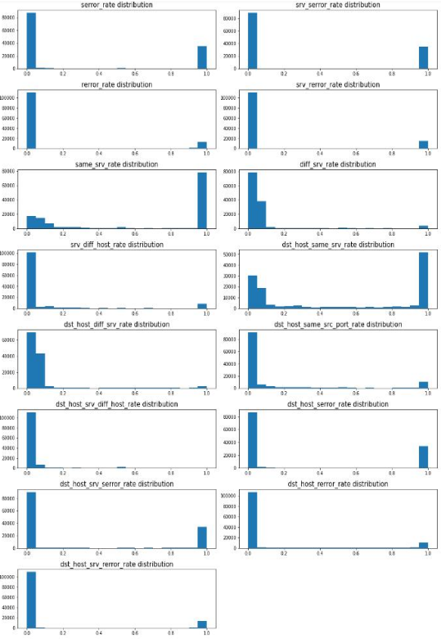
Conceptual Model
3. 1 Conceptual Algorithm based on NSL-KDD Dataset
3.1.4 Features Selections
8
Fig 3.1.4 .2 Correlation between 42 different features in NSL-KDD

Slide 16
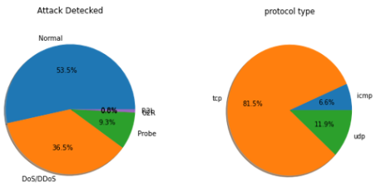
Conceptual Model
3. 1 Conceptual Algorithm based on NSL-KDD Dataset
3.1.4 Features Selections
Volume based attacks seperated based on attack type
Fig 3.1.4 .3 Correlation between Attack types and protocol with correlated features
8

Slide 17
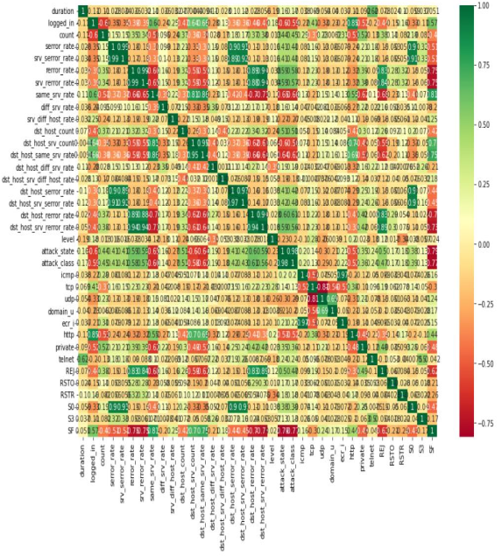
Conceptual Model
3. 1 Conceptual Algorithm based on NSL-KDD Dataset
3.1.5 Types of Attacks
Fig 3.1.4 .4 Correlation of distributions of Attacks
8

Slide 18
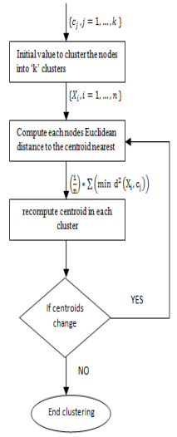
Conceptual Model
3. 1 Conceptual Algorithm based on NSL-KDD Dataset
3.1.6 Algorithm Selection
a. K-Means Clustering (purposed)
Fig 3.1.6.1 Puposed K-means clustering on NSL-KDD
8

Slide 19
5. METHODOLOGY
<number>

Slide 20
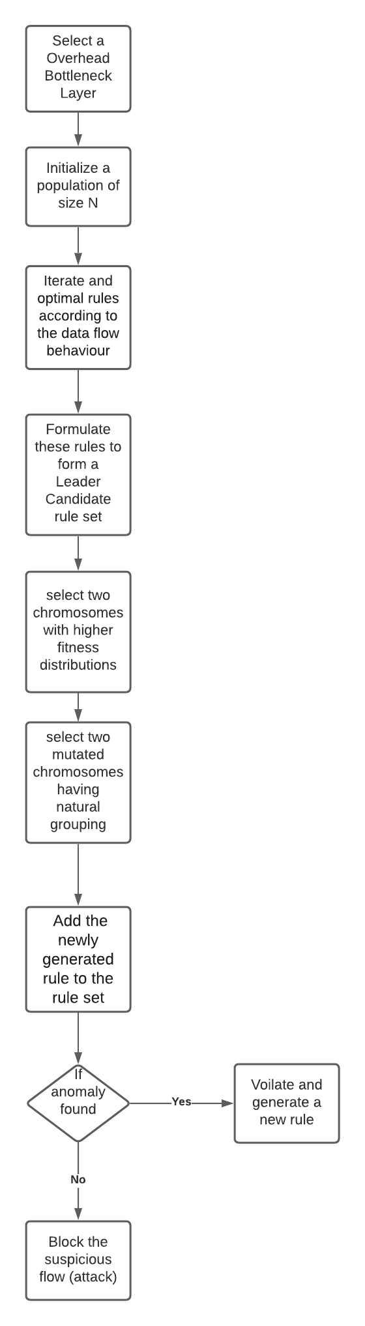
Purposed Methodology
Emulation can be done on mininet
steps are divided into three phases.
bottleneck discovery, selection, and creation.
Detection
detection phase identifies the overloaded controller.
Selection
Election phase identifies controllers as a leader, vice leader and elite.
leader seeks the optimal cluster configuration.
Creation
Create new rules to handle flow request.
Selection
VL as leader if a leader is targeted by a DDoS attack.
Create new rules
14

Slide 21
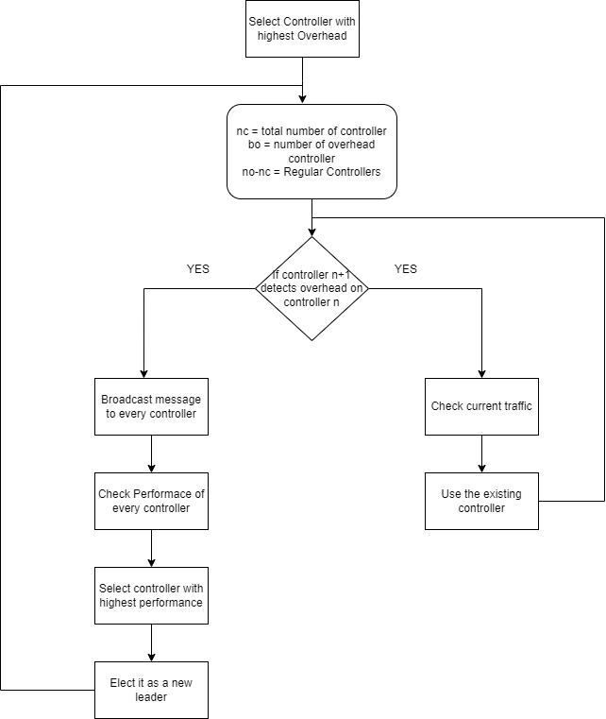
Purposed Methodology
Selection Criteria
15

Slide 22
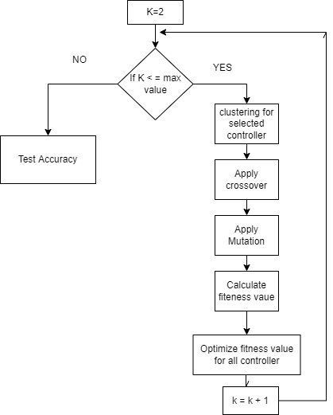
Purposed Methodology
Selection Criteria to minimize fitness value
Initially k = 2
Mutation rate of 0.01
Scale of Fitness = [-1, 1]
16

Slide 23
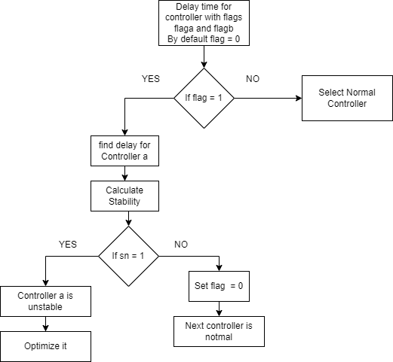
Purposed Methodology
Detection of overhead
17

Slide 24
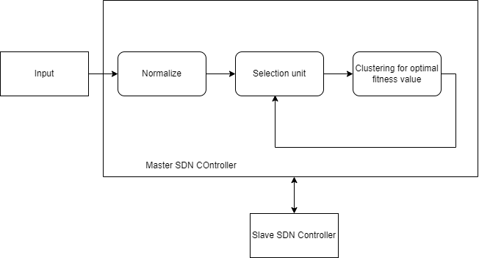
Purposed Methodology
Framework
Alert
18

Slide 25
6. EXPECTED OUTPUT
<number>

Slide 26
Expected Output
To detect how larger network data is spread
To select the efficient controller positions
To reduce overhead
To provide a powerful visualization model for control and monitor of Network Flow
20

Slide 27
7. VALIDATION CRITERIA
<number>

Slide 28


Validation Criteria
dividing an initial sample set into training and validation datasets.
inferring the model with the training dataset.
evaluating the model's quality with the validation dataset.
CPU speed, delay, Network fluctuations are analysed and Detection rate is determined.
The detection rate classifies the traffic as legitimate or not
22

Slide 29
8. REFERENCES
<number>

Slide 30
References
[1] L. Yao, P. Hong and W. Zhou, "Evaluating the controller capacity in software defined networking," 2014 23rd International Conference on Computer Communication and Networks (ICCCN), 2014, pp. 1-6, doi: 10.1109/ICCCN.2014.6911857.
[2] Ali J, Roh Bh, Lee S, “QoS improvement with an optimum controller selection for software-defined networks,”, 2019, PLOS ONE 14(5): e0217631, doi: 10.1371/journal.pone.0217631
[3] Nam, Tran Manh et al. “Self-organizing map-based approaches in DDoS flooding detection using SDN.” 2018 International Conference on Information Networking (ICOIN) (2018): 249-254.
[4] Jagdeep Singh, Sunny Behal, Detection and mitigation of DDoS attacks in SDN: A comprehensive review, research challenges and future directions, Computer Science Review, Volume 37, 2020, 100279, ISSN 1574-0137, doi: 10.1016/j.cosrev.2020.100279.
24

Slide 31
References
[5] P. Preamthaisong, A. Auyporntrakool, P. Aimtongkham, T. Sriwuttisap and C. So-In, "Enhanced DDoS Detection using Hybrid Genetic Algorithm and Decision Tree for SDN," 2019 16th International Joint Conference on Computer Science and Software Engineering (JCSSE), 2019, pp. 152-157, doi: 10.1109/JCSSE.2019.8864216.
[6] R. Braga, E. Mota and A. Passito, "Lightweight DDoS flooding attack detection using NOX/OpenFlow," IEEE Local Computer Network Conference, 2010, pp. 408-415, doi: 10.1109/LCN.2010.5735752.
[7] Harikrishna, P., Amuthan, A. SDN-based DDoS Attack Mitigation Scheme using Convolution Recursively Enhanced Self Organizing Maps. Sādhanā 45, 104 (2020). Doi: 10.1007/s12046-020-01353-x
[8] Karnwal, Tarun & Sivakumar, T. & Gnanasekaran, Aghila. (2012). A filter tree approach to protect cloud computing against XML DDoS and HTTP DDoS attack. Advances in Intelligent Systems and Computing. 182. 10.1109/SCEECS.2012.6184829.
25

Slide 32
References
[9] S. M. Mousavi and M. St-Hilaire, "Early detection of DDoS attacks against SDN controllers," 2015 International Conference on Computing, Networking and Communications (ICNC), 2015, pp. 77-81, doi: 10.1109/ICCNC.2015.7069319.
[10] S. Dong and M. Sarem, "DDoS Attack Detection Method Based on Improved KNN With the Degree of DDoS Attack in Software-Defined Networks," in IEEE Access, vol. 8, pp. 5039-5048, 2020, doi: 10.1109/ACCESS.2019.2963077.
[11] H. Peng, Z. Sun, X. Zhao, S. Tan and Z. Sun, "A Detection Method for Anomaly Flow in Software Defined Network," in IEEE Access, vol. 6, pp. 27809-27817, 2018, doi: 10.1109/ACCESS.2018.2839684.
[12] Seungwon, Shin & Yegneswaran, Vinod & Porras, Phillip & Gu, Guofei. (2013). AVANT-GUARD: scalable and vigilant switch flow management in software-defined networks. 10.1145/2508859.2516684.
26

Slide 33
References
[13] Ambrosin, Moreno & Conti, Mauro & De Gaspari, Fabio & Poovendran, Radha. (2015). LineSwitch: Efficiently Managing Switch Flow in Software-Defined Networking while Effectively Tackling DoS Attacks. ASIACCS 2015 - Proceedings of the 10th ACM Symposium on Information, Computer and Communications Security. 10.1145/2714576.2714612.
[14] Iranmanesh, Amir & Naji, Hamid. (2021). A protocol for cluster confirmations of SDN controllers against DDoS attacks. Computers & Electrical Engineering. Volume 93. 10.1016/j.compeleceng.2021.107265.
[15] Islam, Md & Estivill-Castro, Vladimir & Rahman, Md Anisur & Bossomaier, Terry. (2017). Combining K-Means and a Genetic Algorithm through a Novel Arrangement of Genetic Operators for High Quality Clustering. Expert Systems with Applications. 91. 402-417. 10.1016/j.eswa.2017.09.005.
27

Slide 34
QUESTIONS
<number>

